Slide 1
NIST CSF
為什麼? 重要性?

Slide 2
agenda
Cybersecurity threats
NIST
CSF
Framework
Benefits 用處

Slide 3
Cybersecurity threats

Slide 4
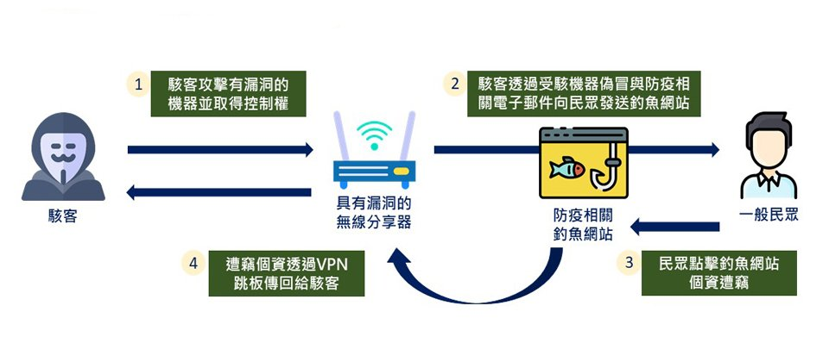

Slide 5
Ransomeware

Slide 6
IOT security

Slide 7
NIST

Slide 8
NIST CSF

Slide 9
The Framework is a risk-based approach to managing cybersecurity risk, and is composed of three parts:
the Framework Core,
the Framework Implementation Tiers, and
the Framework Profiles.
1 | the Framework Core
2 | the Framework Implementation Tiers
3 | the Framework Profiles

Slide 11
Framework Core

Slide 12
the Framework Core

Slide 13
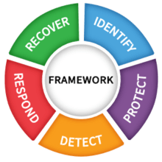
The Framework Core consists of five concurrent and continuous Functions—Identify, Protect, Detect, Respond,Recover
1 | Identify
2 | Protect
3 | Detect
4 | Respond
5 | Recover
When considered together, these Functions provide a high-level, strategic view of the lifecycle of an organization’s management of cybersecurity risk.
The Framework Core then identifies underlying key Categories and Subcategories – which are discrete outcomes – for each Function, and matches them with example Informative References such as existing standards, guidelines, and practices for each Subcategory.

Slide 14
1 Identify
ID.AM | Asset Management (ID.AM): The data, personnel, devices, systems, and facilities that enable the organization to achieve business purposes are identified and managed consistent with their relative importance to organizational objectives and the organization’s risk strategy.

Slide 15
Asset Management (ID.AM)
ID.AM-1 | Physical devices and systems within the organization are inventoried

Slide 16
Asset Management (ID.AM): The data, personnel, devices, systems, and facilities that enable the organization to achieve business purposes are identified and managed consistent with their relative importance to organizational objectives and the organization’s risk strategy.

Slide 17
Framework Implementation Tiers

Slide 18
Framework Implementation Tiers

Slide 19
Framework Profiles

